Slide 1

Accelerating Infrastructure Development through Partnerships
Luthando Jack
DVC People and Operations
Infrastructure Investment Indaba
01 June 2026

Slide 2
Road Map
The Crisis of Student Housing in Higher Education – What are we responding to?
Integrated Vision - Our Aspirational ends
Interlocking underpinning principles and drivers
Student Housing in a Modernising Higher Education located in a Fragmenting Society
Mandela’s Social and Commercial Infrastructure Build Agenda
Governance and Operating Architecture
Post – Indaba Trajectories and Pathways

Slide 3
The Crisis of Student Housing in Higher Education
Post-1994 explosion in student enrolment with annual growth of 2% matched by only 20% capacity available at residential universities (Ministerial Committee report on student housing, 2011).
Shortage of suitable accommodation is a student protest platform
Risks associated with phenomenon of “squatting”
“…variations on [such] public-private partnerships, perhaps involving multiple universities, existing state infrastructural development mechanisms and private sector funding, have the potential to be more cost-effective” (Ministerial committee on student housing, 2011)

Slide 4
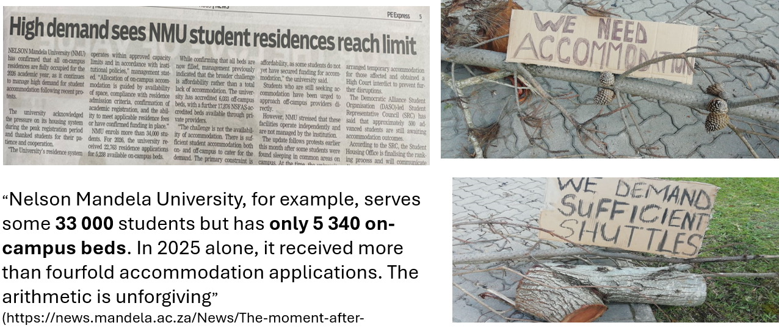
The Crisis of Student Housing in Higher Education

Slide 5
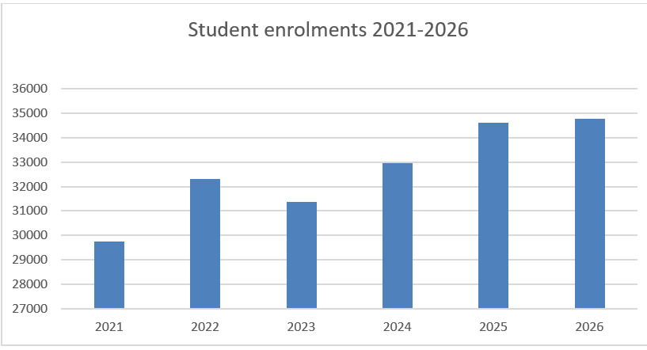
The Mandela’s Growth Trajectory

Slide 6
Vision - Our Aspirational ends
Cultivating humanizing and holistic student experiences that foster agency, belonging, success, well-being and human flourishing

Slide 7
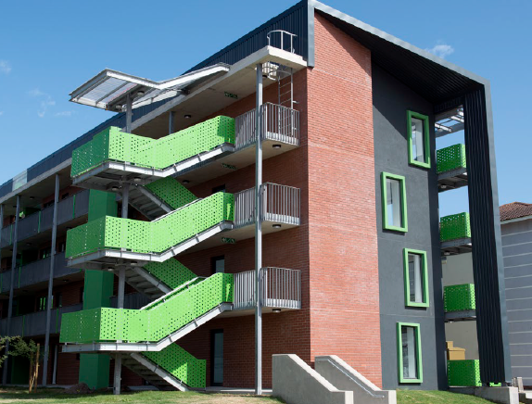
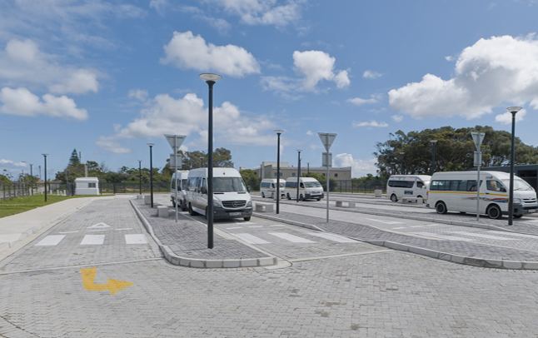
Underpinning Principles and Drivers
Availing safe, dignified and enabling living and learning environments has become inseparable from student access, retention, academic success and overall wellbeing.
NB: University has accredited 14231 off-campus beds - privately owned.
- Unequal student experiences

Slide 8
Interlocking Underpinning Principles and Drivers
Responsibly integrate our respective campuses into their social, economic and environmental location.
Infrastructure geared towards purposeful, productive and stimulating spaces.
Equalise resource distribution across all campuses.
Work towards smart campuses.
Move towards green and climate responsive infrastructure.
Enhance dignity, safety, well-being and holistic development of students

Slide 9
Student Housing in a Moderninsing Higher Education Located in a Fragmenting Society
Hybrid ways of deploying higher education have changed the role of student residences.
Student residences play an integrative role of being living student communities, learning spaces, social and recreational spaces – truly human stettlements
Yet, we attract students who come from a fragmenting society:
  Social fragmentation
  Value system that is supposed to hold us together
  Violent crimes including GBVH
  Family as basic unit of society – fracturing?
The University is navigating this complexity and contradiction

Slide 10
Mandela’s Infrastructure Build Agenda
Build 10 000 beds in the next five years in five campuses – George and Gqeberha
Develop student housing on University land - priority
Develop student housing on municipal and public works land – innovative partnerships
Embark on the development of associated commercial infrastructure to ameliorate campus experience and vibrancy:
Student centres - Allied services – supermarkets, banks, eateries, laundromats, bookstores and IT shops etc
Emterprenership Innovation hub
Hotel school
Co-construct innovative and sustainable funding models for social and commercial infrastructure
Deploy multi-agency partnerships with state and non-state actors to boldly drive game changing infrastructure development for higher education

Slide 11
Governance and Operating Architecture
Run student housing as a social enterprise
Robust property management standards and models
Self-sustainability
Enhance existing governance and operating models
Explore new operating models based on emerging partnerships

Slide 12

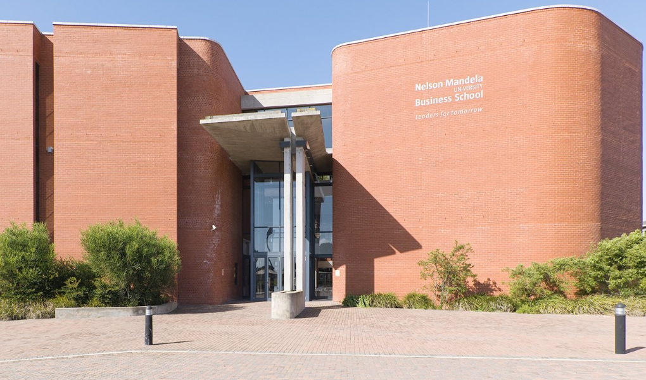
Governance and Operating Architecture
Call for innovative partnership models utilizing available financial instruments to accelerate infrastructure development:
Enabling policies
Delivery vehicles
Shared risks and opportunities
Critical role by all Invited stakeholders.
“From III to PPP”

Slide 13
Post – Indaba Trajectories and Pathways
Finalise financing model
Firm up governance and operating architecture
Firm up the policy architecture
Formally go to the market
Embark on integrated and phased programming – mapped pathways
Deployment, execution and partnerships management

Slide 14
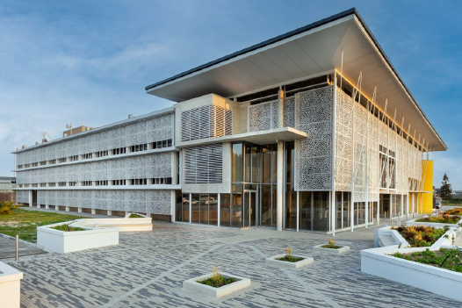
Post – Indaba Trajectories and Pathways
“…Once the state has indicated what proportion of this target it is able to fund, the private sector should be invited to meet the remaining bed capacity target”
(Ministerial report on student housing, 2011).

Slide 15


