Slide 1


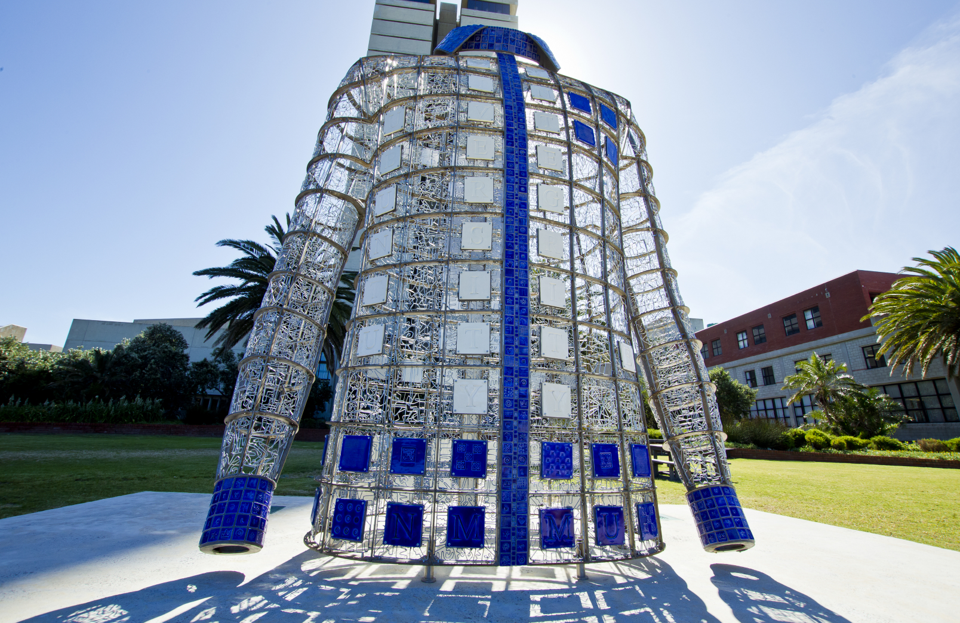
Towards an enrolment management strategy:
2024 statistics & institutional research
Professor Heather Nel
Senior Director: Institutional Strategy
25 March 2024

Slide 2
CONTEXT AND STRATEGIC OVERVIEW

Slide 3


External factors impacting enrolment management
Demographics
Incoming students
Existing students
Staff
Feeder Institutions
Schools
TVET colleges
Other universities
Labour Market
Employment trends
Future world of work
Curriculum responsiveness
Competition
Other PSET institutions
Local – global
Public-private
Public Policy
Differentiated PSET sector
State funding
Enrolment planning
Quality advancement
Opportunity Costs
Target markets
Selection process
Academic size & shape
Modes of delivery
Funding

Slide 4

Vision 2030 alignment

Slide 5

Transversal strategic differentiators
Medical school
Ocean sciences
Revitalising the humanities
Repositioning engagement
Transdisciplinary sustainability science
Food sovereignty and security
Digitalisation and the Virtual Academy
Transformative institutional culture
Student entrepreneurship and youth employability

Slide 6
Key dimensions of enrolment management strategy
Strategic differentiators & high-quality academic offerings
Resource mobilisation and stewardship
Vibrant campus life and student-centric support services
Highly qualified and engaged staff
Student recruitment & retention strategy
Inclusive, affirming institutional culture
User-friendly, integrated, digitalised systems & processes
Modernised, flexibly designed infrastructure

Slide 7
ENROLMENT STATISTICS FOR 2024
(19 March 2024)

Slide 8
2024 Enrolments by qualification type compared to targets
Qualification Type | 2022 | 2023 | 2024 Actual 19 March | 2024 APP Target | Deviation from APP Target | Enrolment Plan Targets | Deviation from Enrolment Plan Target
UG Diploma or Certificate | 12 307 | 11 965 | 12 009 | 12 100 | -1% | 11 260 | 7%
Advanced Diploma | 1 752 | 1 744 | 1 576 | 1 800 | -12% | 1 900 | -17%
UG Degree | 14 639 | 14 669 | 15 725 | 14 702 | 7% | 14 490 | 9%
Total UG | 28 698 | 28 378 | 29 310 | 28 602 | 2% | 27 650 | 6%
PG Diploma | 527 | 435 | 503 | 447 | 13% | 578 | -13%
Honours | 829 | 739 | 723 | 760 | -5% | 982 | -26%
Master's | 1 486 | 1 402 | 1132 | 1 460 | -22% | 1 770 | -36%
Doctoral | 568 | 537 | 393 | 555 | -29% | 665 | -41%
Total PG | 3 410 | 3 113 | 2 751 | 3 222 | -15% | 3 995 | -31%
Occasional | 212 | 182 | 97 | 200 | -52% | 260 | -63%
Grand total | 32 320 | 31 673 | 32 158 | 32 024 | 0% | 31 905 | 1%

Slide 9
Deviations of the 2024 enrolments from the APP 2024 and the enrolment plan

Slide 10
Average annual growth rate by qualification type: 2020 - 2024

Slide 11
First-time entering undergraduate enrolments compared to targets

Slide 12
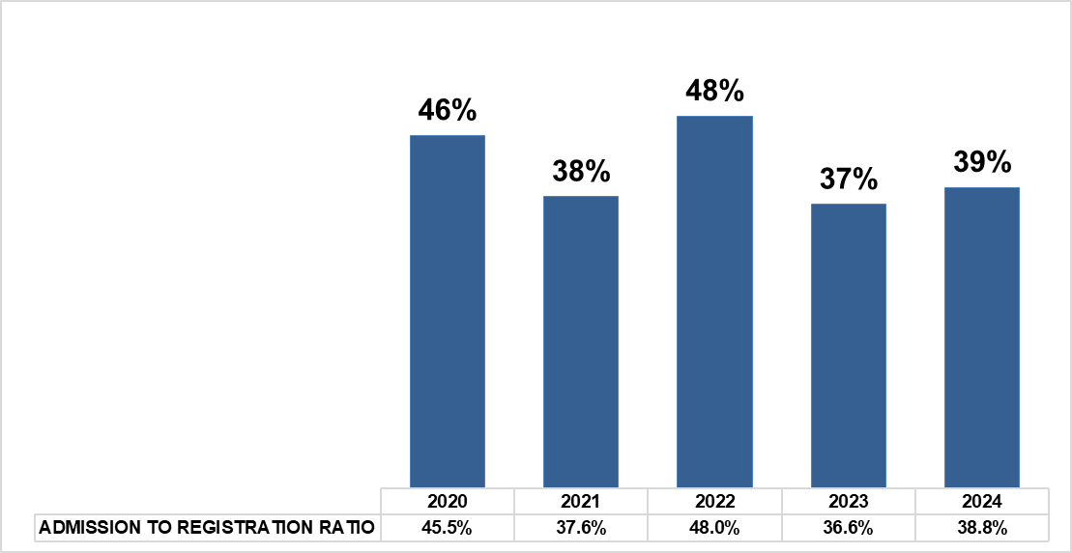
First-time entering students: Registration to admission ratio, 2020 - 2024
First-time entering students: Registration to admission ratio, 2020 - 2024

Slide 13
% matriculants entering the University by quintile, 2020 - 2024

Slide 14
Percentage enrolments by population group, 2020 – 2024

Slide 15
Percentage enrolments by gender, 2020 – 2024

Slide 16
Headcount enrolments by region, 2020 - 2024

Slide 17
International enrolments: 2020 - 2024

Slide 18
POSTGRADUATE STUDENTS’ EXPERIENCES OF ACCESS AT NELSON MANDELA UNIVERSITY

Slide 19

Study of postgraduate student experience of access
AIM OF STUDY: To explore and describe postgraduate students’ experiences of access at Nelson Mandela University.
METHODOLOGY: Mixed methods research (combination of quantitative and qualitative approaches) to reveal a comprehensive picture of enablers and barriers of access to postgraduate studies.

Slide 20
Methodology and dimensions of the study
2: NON-REGISTRATION SURVEY
Analyse the experiences of PG students who were accepted to study at Nelson Mandela University but did not register.
TELEPHONIC SURVEY
STRATIFIED RANDOM SAMPLE
580 RESPONDENTS
5: ACADEMIC & PASS STAFF PERCEPTIONS OF PG ACCESS FOR SUCCESS
Analyse the perceptions of staff involved in the PG access value chain regarding barriers and enablers to PG access for success.
FOCUS GROUPS
NOT YET COMPLETED
1: BENCHMARKING
Examine national enrolment trends, PG application and enrolment practices, provision of financial and academic support, and identify possible best practices
BENCHMARKING SURVEY
8 INSTITUTIONS RESPONDED
3: FOCUS GROUPS WITH FIRST-YEAR POSTGRADUATE STUDENTS
Explore perceptions of Nelson Mandela University PG students currently in their first year regarding barriers and enablers to access.
FOCUS GROUP DISCUSSIONS
8 FOCUS GROUPS
4: POSTGRADUATE STUDENT PROFILE - INFOGRAPHIC
Compile a profile of current PG students at Nelson Mandela University and analyse recent historical trends.
ANALYSIS OF NUMEROUS POSTGRADUATE INDICATORS
INFOGRAPHIC REPORT

Slide 21
Benchmarking - Findings
  UNIVERSITY POSTGRADUATE ENROLMENT TRENDS
  The decline in PG enrolments is a shared phenomenon across the sector over the last 5 years, although UCT maintained its numbers and VUT experienced an increase in enrolments.
  POSTGRADUATE RECRUITMENT POLICY OR STRATEGY
  Six out of the eight benchmarked universities indicated that they did not yet have a specific PG recruitment strategy.
  UP indicated that they had started a postgraduate review process in 2020 that led to streamlining the PG life cycle.
  UL indicated that they had developed a PG strategy that was submitted to Senate on 25 November 2023.
  UWC is developing a strategy.
  UJ, UL, and VUT primarily use the website, internet, and social media for promoting PG studies.
  Prospective students are also reached through recruitment drives by University Marketing departments.
  UCT and RU leverage their histories and reputations to attract students and do not have specific strategies.
  Many of the universities stressed the importance of promoting PG studies to current students through departments/faculties.

Slide 22


  INCENTIVES TO ATTRACT POSTGRADUATE STUDENTS
  UFH offers tuition waivers to M&D candidates.
  VUT offers awards to PG students whose proposals are completed within a year of registration and offers discounts to all registered staff.
BENCHMARKING - FINDINGS

Slide 23
Benchmarking - Findings
POSTGRADUATE APPLICATION FEES
For some universities, application fees are compulsory, while in others not. At some, there are no application fees.
At UCT, South African and SADC applicants pay R100, and those from outside SADC pay R300. The Graduate School of Business has a different fee regime.
UFH charges R120 for South Africans and R500 for international applicants.
UL charges R200 for South Africans and R750 for international applicants.
UP charges R300 for all applicants.
RU charges R100 for all applicants, which is not compulsory.
The other three institutions do not charge application fees.

Slide 24
Benchmarking - Findings
POSTGRADUATE FUNDING AVAILABILITY
All participating universities noted a downward trend in PG funding in South Africa.
Six out of eight universities indicated that they guaranteed merit-based PG funding.
Six universities also stated that funding was only offered to students once they had enrolled at the university. UCT is the only institution that offers funding to students who have not yet registered.
RU indicated that, in addition to available bursaries and scholarships, they also fund PG students through supervisor-linked scholarships
UFH waivers tuition fees for M&D candidates and relies on supervisor-linked scholarships.
POSTGRADUATE SUPPORT SERVICES
Six universities had PG centres that offer a myriad of services such as funding, academic writing and support, counselling, research data management, research skills development, certified short courses, qualitative and quantitative data handling and analysis training, and writing retreats, amongst other things.

Slide 25
Benchmarking - Findings
CHALLENGES IN RECRUITING AND RETAINING POSTGRADUATE STUDENTS
Limited/diminishing funding was the top challenge indicated by all universities.
UP mentioned that “diminishing research funding, supervisory capacity, immigration challenges, and delays with SAQA verification and completion times” are some of the issues.
UJ stated that students prefer to attend HEIs that offer bigger bursaries, so the lack of resources also plays a role and “…limits the recruitment numbers.”
UL listed the following challenges:
  Limited postgraduate scholarships available
  Not responding to applications timeously
  International students have issues with work permits/visas
  Supervisory capacity
  Many students do not meet the admissions requirements
  Proposal development takes a long time

Slide 26
Benchmarking - Findings
SUCCESSES IN RECRUITING AND RETAINING POSTGRADUATE STUDENTS
The five responding institutions stated that recruitment was the purview of faculties and the Marketing department.
Those universities with more funding have the edge.
UWC stated that institutional reputation and low tuition fees are key to attracting PG students.
UJ and UL focus on their senior UG students as a pool to recruit PG students.
RU credits its wide offering of excellent PG student support as a critical success factor in attracting and retaining PG students.
Some universities stated that in the absence of institutional PG recruitment strategies, departments/academics/grant holders/supervisors attract or recruit their PG students as needed.

Slide 27
Benchmarking - Recommendations
Develop a strategy aimed at recruiting and retaining PG students.
Prioritise the mobilisation of PG funding and widen the reach for international funding.
Assess whether to offer an application fee waiver or offer bursaries and scholarships to PG students who have not yet registered.
Expand and deepen national awareness of the University brand, location, and academic offerings through marketing and outreach, including using current PG students and alumni as ambassadors.
Develop, implement, and monitor a targeted marketing and outreach strategy to international PG students.
Be deliberate in the recruitment of established scholars who hold grants to ease the heavy reliance on the PGRS.
Focus on short turnaround times for processing PG applications and providing feedback.
Prioritise processing of international applicants to allow ample time for visa applications.
Consider accepting research-only PG applications throughout the year.
Conduct an in-depth analysis of PG supervisory capacity at the departmental and programme level, including completion and throughput rates to allow for new intakes.
Offer online postgraduate programmes - students are no longer constrained by geographical location.

Slide 28
Non-registration survey – Key findings
86% responded that Nelson Mandela University was their institution of 1st choice for PG studies

Slide 29
Non-registration survey – Key findings
Why Mandela University was not 1st choice for PG studies
Notes:
n = 81 participants responded “No”

Slide 30
Non-registration survey – Key findings
Main reasons for not registering at Nelson Mandela University for PG studies
Notes:
n = 580

Slide 31
Non-registration survey – Key findings
81% needed financial support to pursue PG studies
Notes:
“Yes”: n = 469 (81%)
Percentages per concern calculated out of 469

Slide 32

Focus Group Discussions - Key Findings
Reasons for pursuing postgraduate studies at Nelson Mandela University
Quality of education offered in specific programmes/departments
Convenience - continuity and geographical location
Financial reasons - affordability of fees

Slide 33
Focus Group Discussions - Key Findings
EXPERIENCES OF FIRST-YEAR POSTGRADUATE STUDENTS OF THE NELSON MANDELA UNIVERSITY APPLICATIONS AND ADMISSIONS PROCESSES
Most participants found the application process to be easy, convenient, and seamless, facilitated by an easily navigable website and departmental assistance.
All participants who registered from other universities found the experience of enrolling at Nelson Mandela University relatively easy.
Some participants experienced delays in getting accepted - a slow turnaround time for their acceptance status, with provisional acceptance being granted quickly, but final acceptance taking several months.
Some participants expressed difficulties related to obtaining information about specific courses offered, as well as a lack of guidance on how to apply for PG studies. A lack of proactive information dissemination required students to independently seek out information.
Some participants faced technical issues with the online system when trying to submit documents.
Experiences and perceptions of the applications and admissions processes depended on the participant’s level of study, with those pursuing PG Diplomas studies experiencing fewer challenges than those pursuing Honours, Master’s, and Doctoral studies. International students faced specific challenges.
Enablers for registration: Free registration, good academic performance, and the availability of second-choice options. In addition, assistance from the admissions office and departmental staff also contributed to an easy transition to registration.

Slide 34
Focus Group Discussions - Key Findings
POSTGRADUATE FUNDING AT NELSON MANDELA UNIVERSITY
Participants highlighted the challenges of securing funding for PG studies as a barrier.
Hardships are faced by part-time students in securing funding, which directly impacts their capacity to cover tuition fees and accommodation costs. This financial strain raises concerns about their ability to continue their PG studies.
Few participants were externally or self-funded. Those who were self-funded indicated that they managed through their own incomes and/or through their parents. Self-funded postgraduate students were typically older, and/or enrolled for their M&D studies. Those funded externally were either supported by their employers and/or government entities. These students also struggle financially with some resorting to covering expenses through fundraising initiatives and part-time employment.
Participants also highlighted limited communication regarding PG funding options available.
Challenges with securing accommodation were also raised. On-campus accommodation was in short supply and expensive.

Slide 35
Focus Group Discussions - Key Findings
SUGGESTIONS TO IMPROVE CONVERSION OF PG APPLICATIONS TO REGISTRATIONS
Postgraduate open days.
Early research exposure to prepare the students for the transition from UG to PG studies. It was further suggested that this may assist in reducing the dropout rates.
Extending the application period for the PGRS funding to allow students to apply when they have been accepted for their PG studies.
Clear communication.
Improved support from departments and academic staff.
It was proposed that application forms should be available in different South African official languages to enhance inclusivity.
Students encouraged each other to pay attention to the University’s communications and to be more proactive.

Slide 36
Focus Group Discussions - Recommendations
Embrace a culture of discussing possibilities of PG studies with senior UG students.
Identify niche PG programmes/qualifications which are recognised nationally and internationally and market these aggressively to attract both internal and external prospective students.
Capacitate PG online application/registration system to withstand high-volume use and rectify the issue regarding uploading of documents.
Encourage administrative staff to embrace an ethic of service and care and provide professional development for departmental and faculty administrators on institutional admission requirements and processes.
Ensure efficient, accurate, and timely communication with PG students once they have applied to ensure they register.
Intensify recruitment of senior academics that hold NRF Chairs and other grant funding sources to supplement institutional funding sources for PG students.
Intensify resource mobilisation for PG scholarships and bursaries, including funding for part-time PG students.
Consider a negotiated percentage reduction in fees to be offered to employers who sponsor further studies for their employees.
Participants underscored the importance of nurturing a vibrant university culture and fostering a sense of belonging among the student community.

Slide 37
In conclusion
Overarching strategy informed by data
Ongoing communication
Integrated, accessible systems & processes
Inclusive institutional culture & ethic of care
Resource mobilisation & funding

Slide 38
Special acknowledgement to:
Dr C Sheppard, Mr G van Leeve, Ms M Neale-Shutte, and Dr S Nomvete from the Office for Institutional Strategy for the data and institutional research findings outlined in this presentation.

