Slide 1


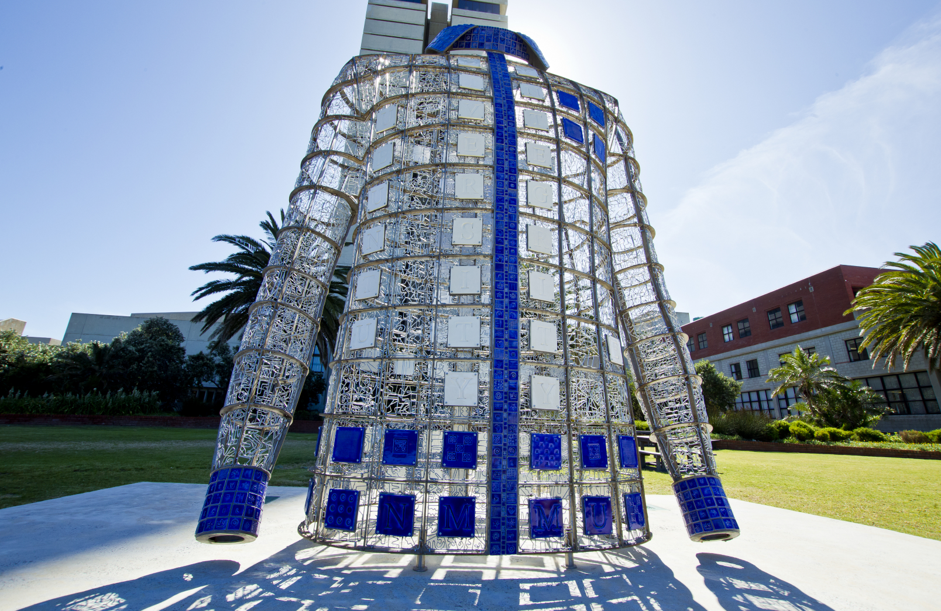
Towards transdisciplinarity
Professor Heather Nel
Office for Institutional Strategy
5 September 2024

Slide 2
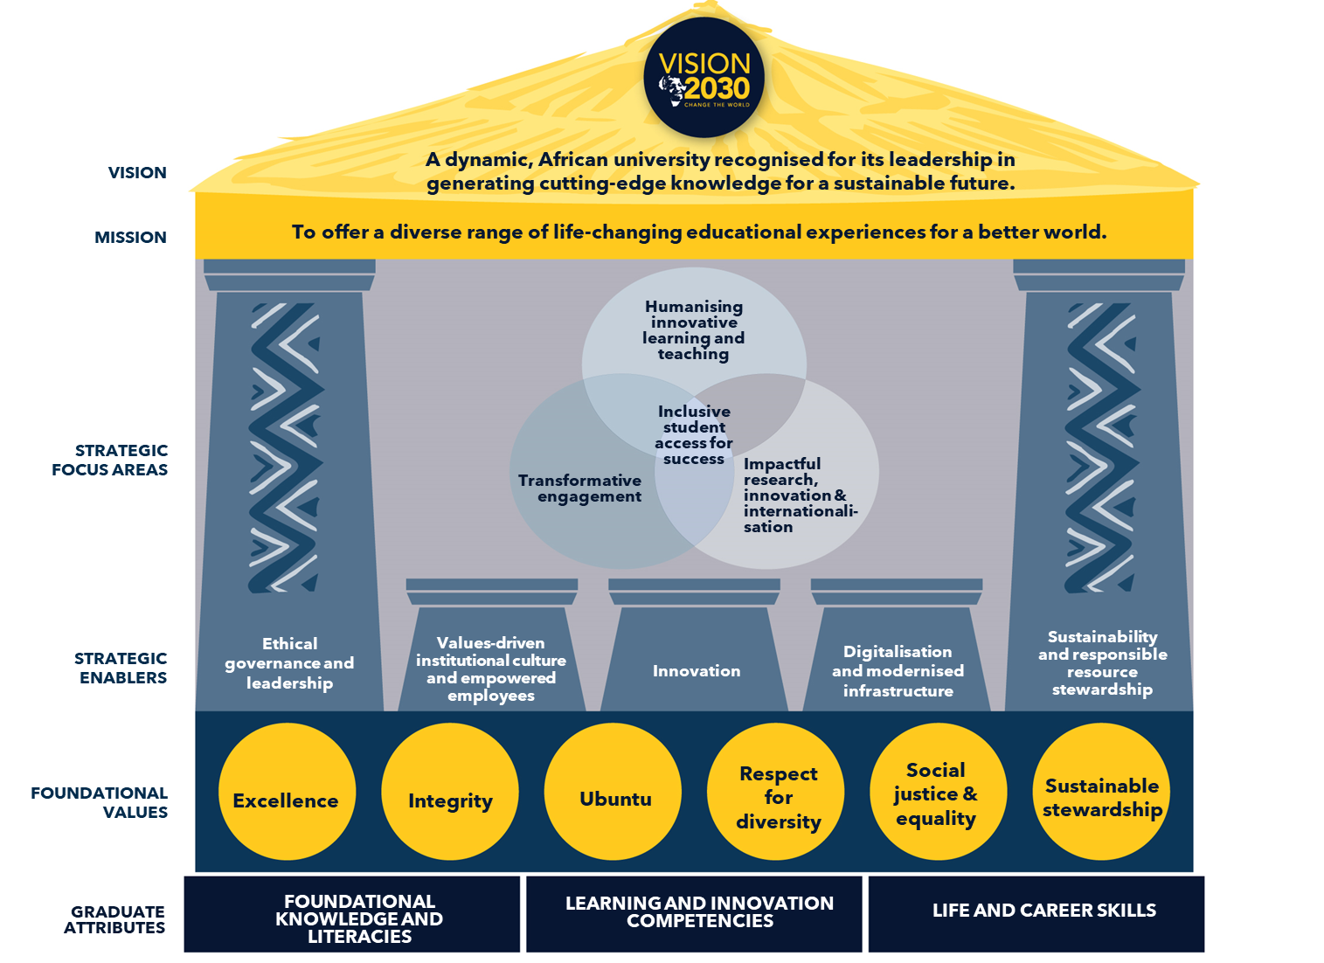
Overview of Vision 2030

Slide 3
Vision 2030 strategic focus areas

Slide 4



Vision 2030 graduate attributes
LIFELONG
LEARNING
FOUNDATIONAL KNOWLEDGE AND LITERACIES
Core disciplinary depth
Inter-disciplinary breadth and synthesis
Knowledge creation
Multiple literacies (academic, digital, numeracy, civic, etc)
Transformative competencies
LEARNING AND INNOVATION COMPETENCIES
Intellectual curiosity
Critical thinking
Innovation and creativity
Communication
Collaboration
LIFE AND CAREER SKILLS
Professionalism and integrity
Resilience and persistence
Adaptive expertise
Socially conscious, responsible global citizens
Progressive agency
LIFELONG
LIFELONG
LEARNING
LEARNING

Slide 5
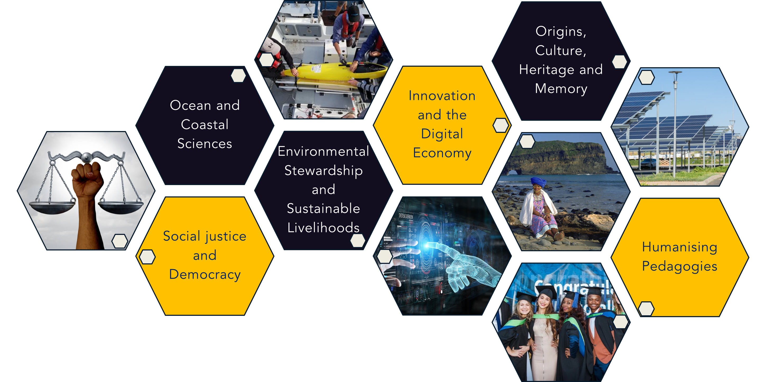
Institutional research themes

Slide 6
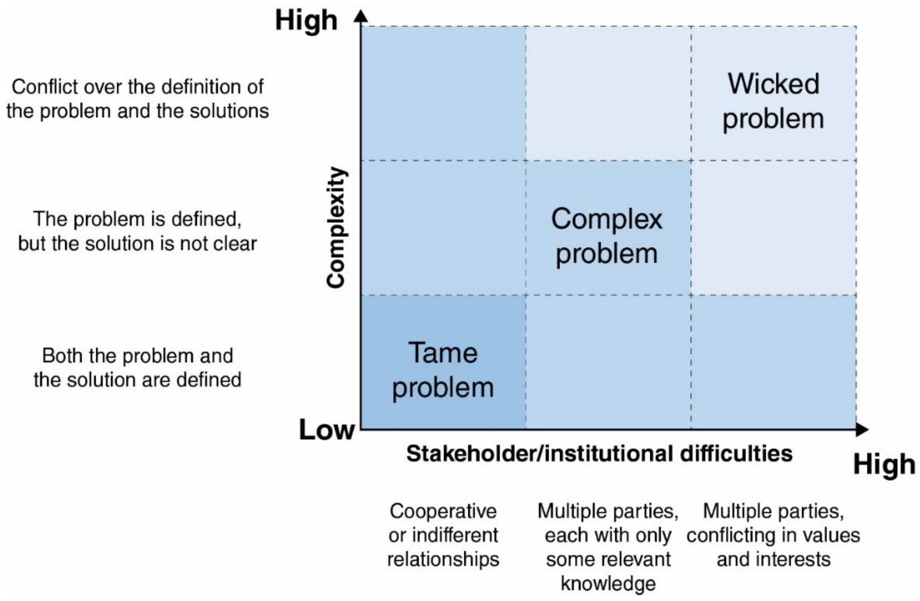
Types of problems
https://www.mdpi.com/2071-1050/12/15/5895#

Slide 7
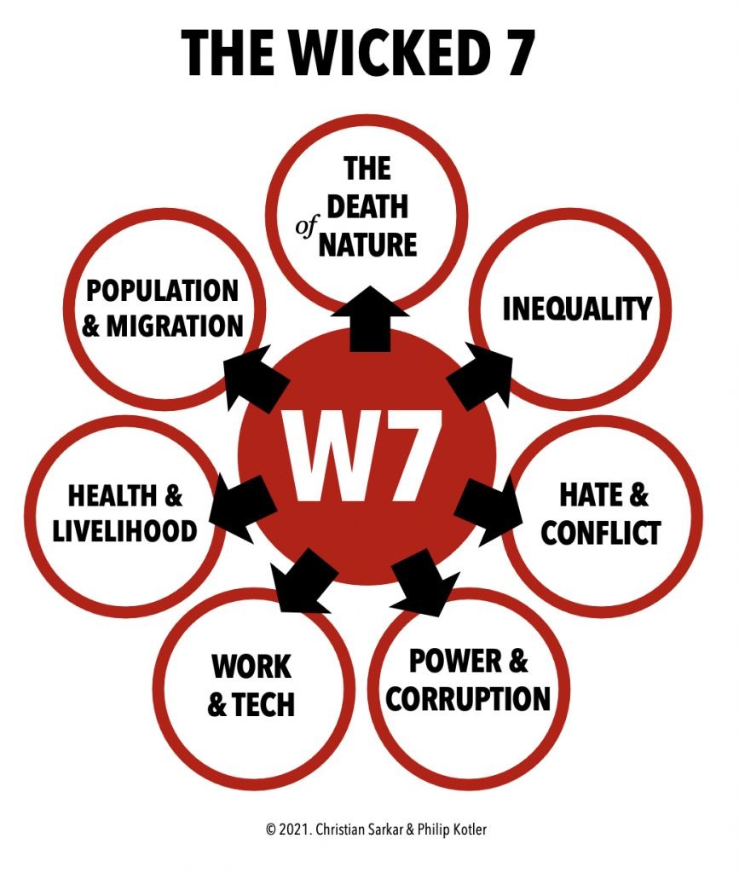
Examples of “wicked” problems

Slide 8
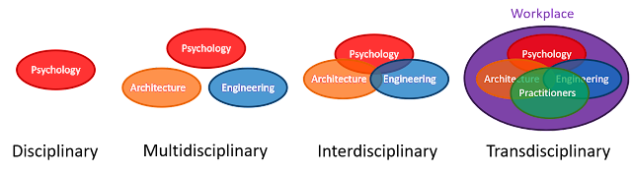
Multi-, inter- and transdisciplinarity
TD is a collaboration between different disciplines/professions with the sharing and application of skills, methodologies, and philosophies.
TD is coordinated to address a real-world theme or problem that requires the perspectives of multiple disciplines/professions.
TD research/project includes input from stakeholders outside the academic disciplines/ professions, such as funders, professional practitioners, policy-makers, and civil society.
http://workplaceunlimited.blogspot.com/2018/10/the-transdisciplinary-workplace.html

Slide 9
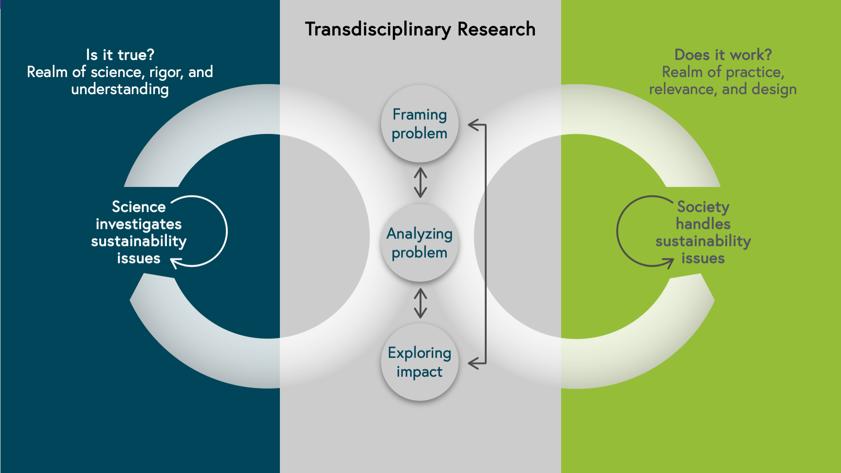
Transdisciplinarity as convergence
https://www.futurelearn.com/info/courses/partnering-for-change/0/steps/91244

Slide 10
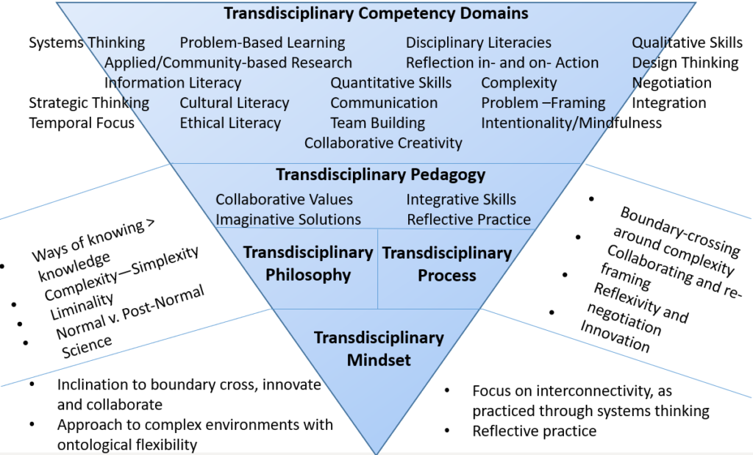
Transdisciplinary mindset
https://my.cgu.edu/transdisciplinary/abilities-domains-and-the-transdisciplinary-mindset/

Slide 11
Enablers of transdisciplinarity
Recognition & rewards
Resource allocation
Staffing arrangements
Organisational design
Spatial proximity
1
Institutional
3
2
Individual
Interactional
Competencies, readiness & motivation to collaborate
Theoretical & methodological flexibility
Diversity of actors, backgrounds, disciplines & locations
Communication & coordination

Slide 12
In conclusion
What innovative institutional and faculty governance, management, structural, and resourcing arrangements are required to facilitate TD?
How will TD shape learning and teaching approaches? How should TD be embedded in the curriculum?
What impact will TD research & innovation have on addressing complex or wicked problems?

